Slide 1
Women
Livelihood
Team 4: CTRL FREAKS
Date: 5 OCT, 2024
Contact:pavanchandu1210@gmail.com

Slide 2
Overview
Empowering women is essential to the health and social development of families, communities and countries . Empowers women in rural areas by providing access to various tools and resources necessary for developing and expanding their businesses .
Goal : Project aims to empower women in rural areas to start and grow their own businesses by developing a comprehensive platform or program
Impact :Project provides Business Training, Skill development, Financial resources, Networking

Slide 3
Why is the project needed ?
● Low financial access: Women are also found to face reduced access to microloans,credit and banking activities, levels of literacy is low.
● Business knowledge: Women lack education and basic business skills,this leaves a major gap.
● Lack of technology: Rural areas lack technological advancements, which does not avail women the tools such as e commerce and digital marketing..

Slide 4
Background
Importance
In INDIA, rural women face challenges in entrepreneurship due to limited access to education, financial resources and socio-cultural constraints.
By empowering women entrepreneurs, the project can enhance gender equality, enhance income generation and reduce poverty.

Slide 5
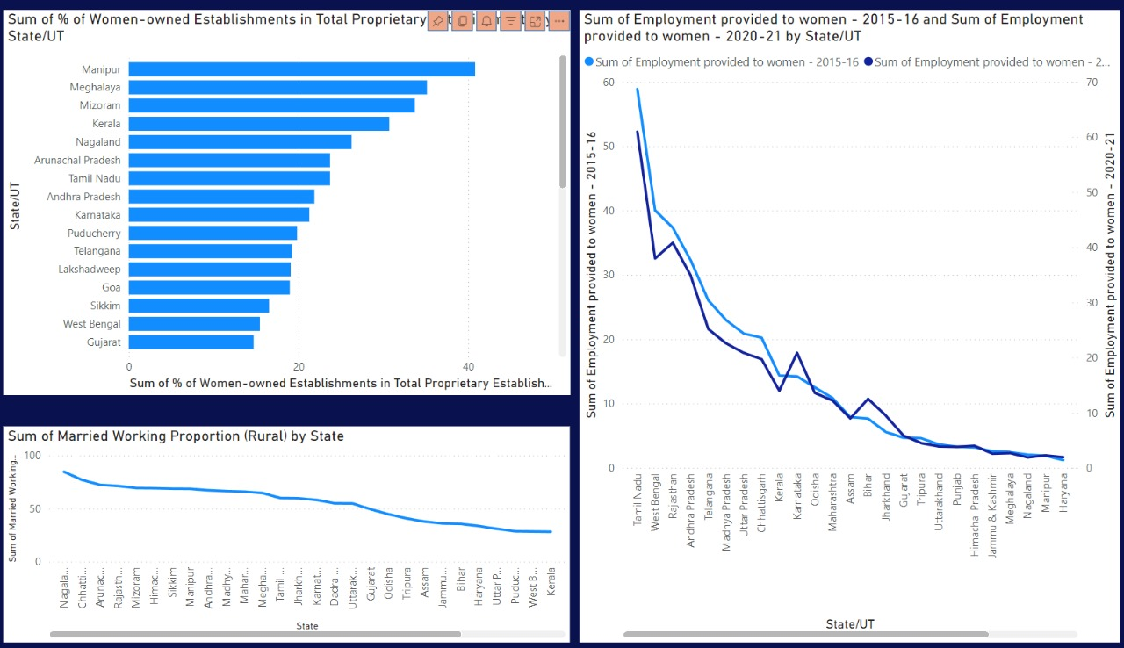
Data Visualization
Chart 1: Sum of % of Women-Owned Establishments in Total Proprietary Establishments
Chart 2: Sum of Employment Provided to Women - 2015-16 and Sum of Employment Provided to Women - 2020-21
Chart 3: Sum of Married Working Proportion (Rural) by State

Slide 6
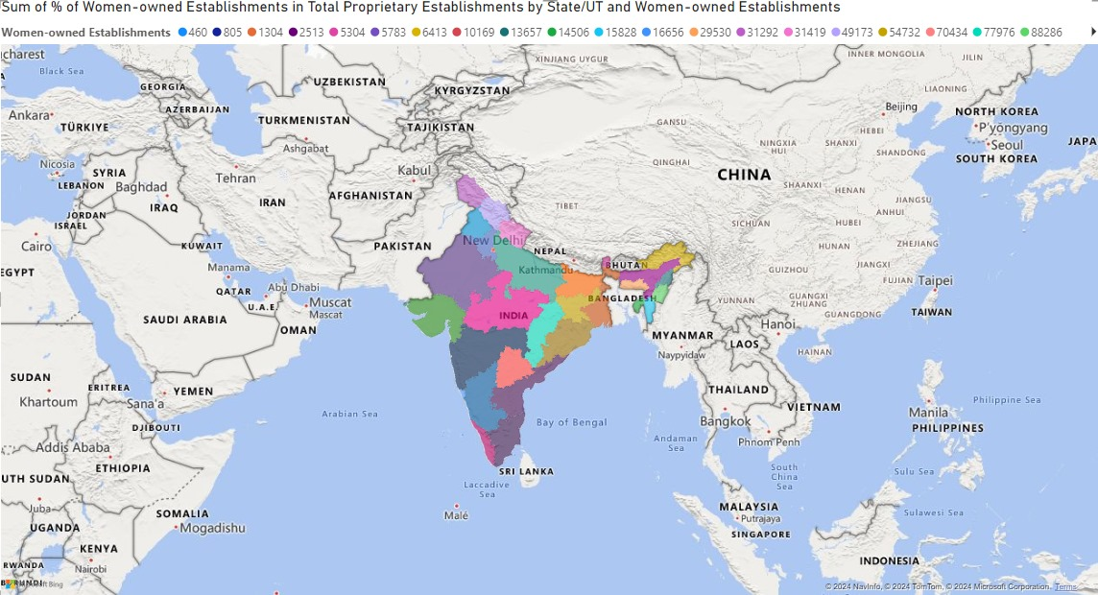
The map illustrates the percentage of women-owned establishments in different states and union territories of India, highlighting regional variations and potential areas for further analysis.

Slide 7
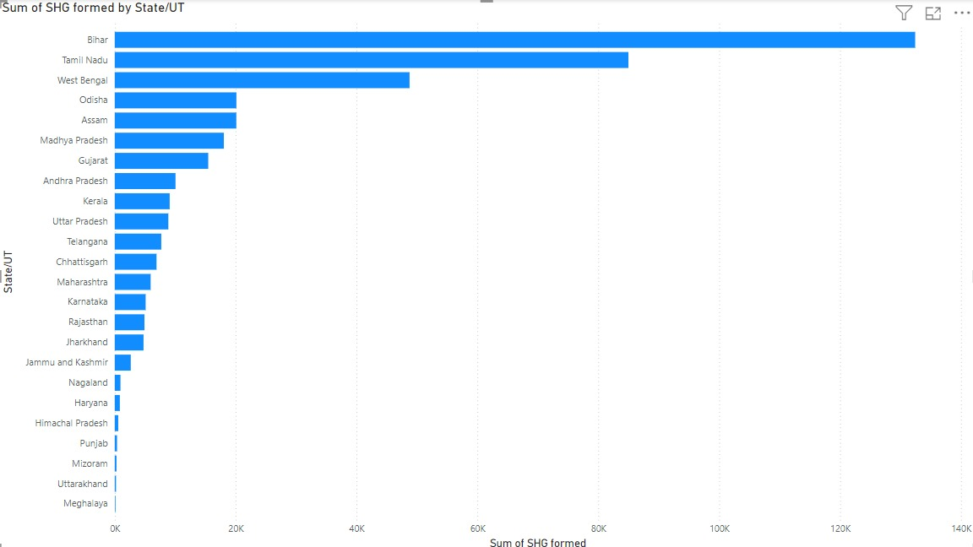
The bar chart illustrates the total number of Self-Help Groups (SHGs) formed in different states and union territories of India, with Bihar having the highest number of SHGs.

Slide 8
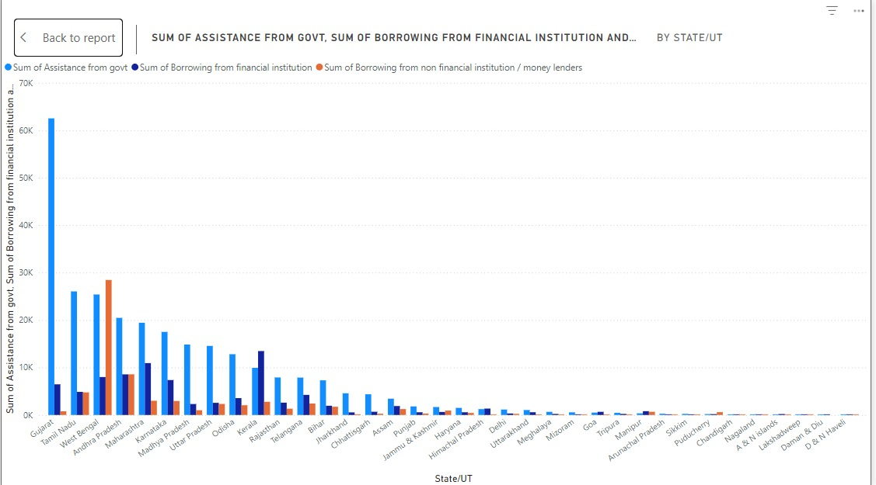
The chart illustrates the financial assistance provided to different states and union territories in India from various sources, highlighting the dominance of government assistance and the variation in funding across regions.

Slide 9
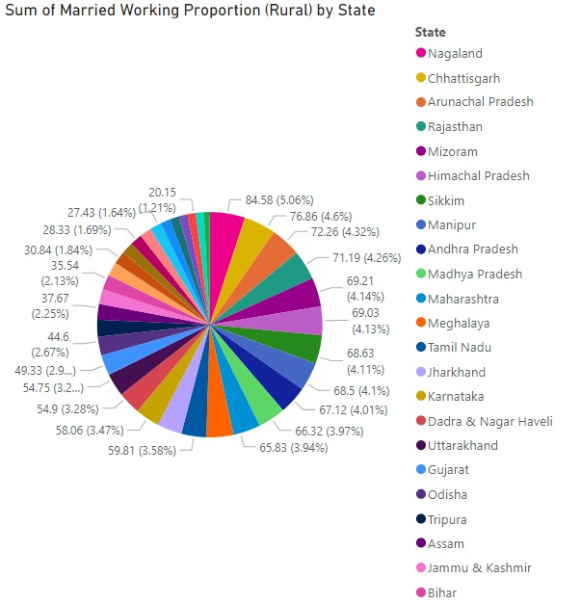
The pie chart illustrates the proportion of married working women in rural areas of different states in India, with Nagaland having the highest proportion and Bihar having the lowest.

Slide 10
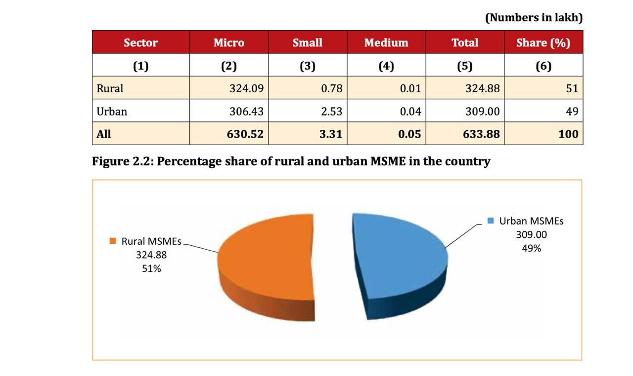
The table and pie chart show the distribution of micro, small, and medium enterprises (MSMEs) in rural and urban areas, with rural MSMEs accounting for 51% and urban MSMEs accounting for 49% of the total MSMEs in the country.

Slide 11
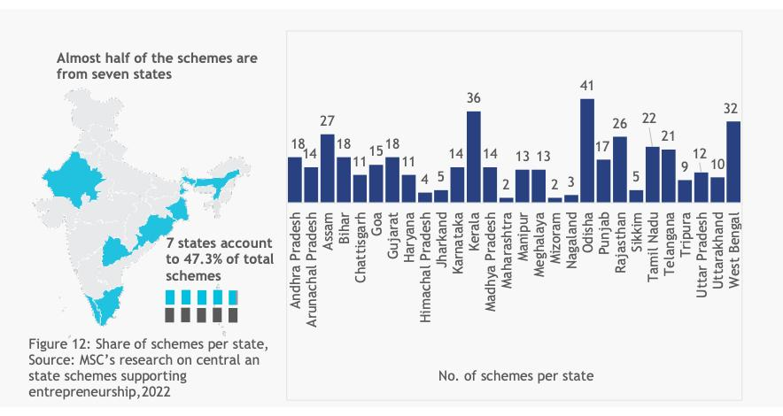
The bar chart illustrates the distribution of central and state schemes supporting entrepreneurship across different states in India, highlighting that almost half of the schemes are concentrated in seven state

Slide 12
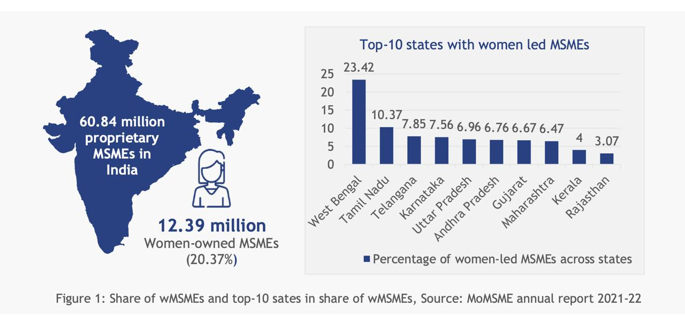
The image illustrates the share of women-led MSMEs in India, highlighting that 12.39 million women-owned MSMEs constitute 20.37% of the total proprietary MSMEs in the country, with West Bengal leading with 23.42% of women-led MSMEs.

Slide 13
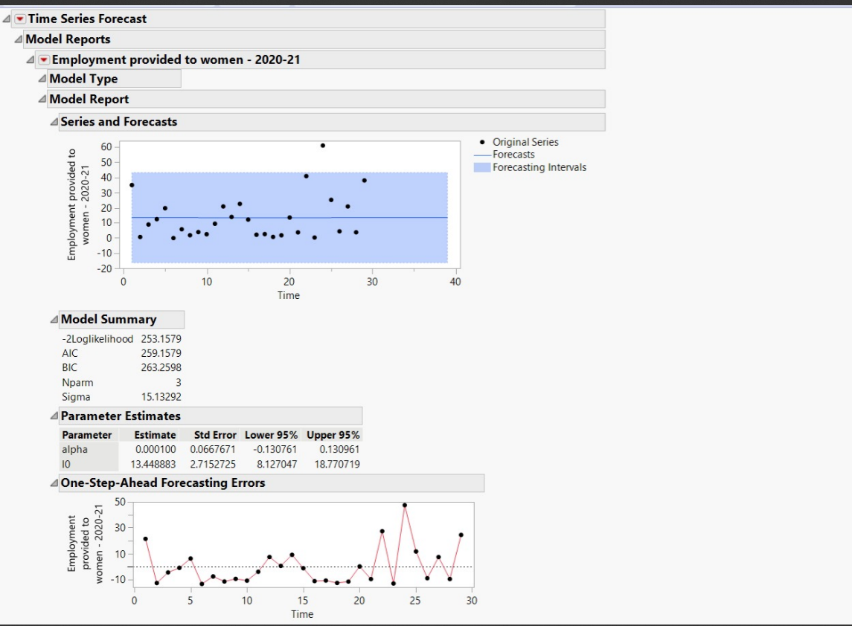
Time Series Forecast for women employment rate

Slide 14
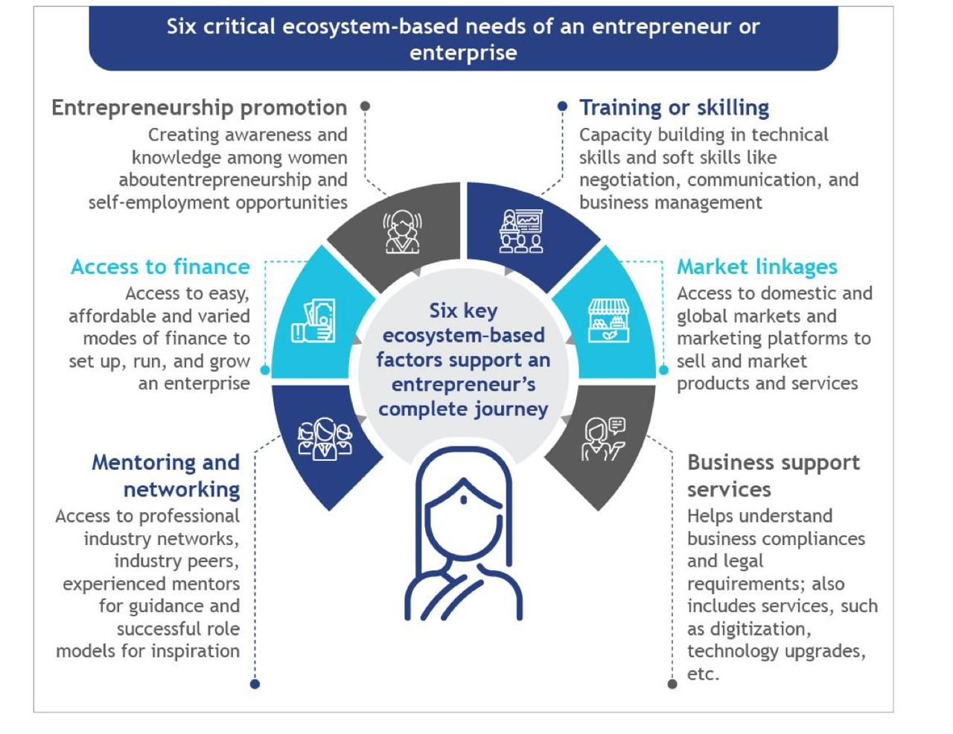

Slide 15
Outcomes:
● Increased entrepreneurship
● Improved financial independence
● Financial access
● Market access
● Business related skill development
● Metric: ● completion/growth rate
● Income growth/loan repayment
● Business net worth growth rate
● Women enrolment

Slide 16
Target population:
● Women with limited access to technology
● Women living in regions of high gender inequality
● Growing female entrepreneurs
● Women with limited financial access
● Women living in remote areas

Slide 17
Project activities:
● Planning
● Develop curriculum
● Recruiting women participants
● Starting the training program
● Initiate market access
● Real time monitoring
● Real time reporting
● Methodology: ● Approach through participation ● Strengthening women entrepreneurs with necessary skills ● Connecting with local businesses and successful entrepreneurs. ● Measuring and evaluation ● Sustainability

Slide 18
Monitoring and evaluation:
Monitoring framework helps us to keep track on each and every activity that’s going on.
● This measures project outputs and outcomes.
● Monitoring financial growth and businesses.
● Financial literacy
● Number of businesses successfully growing
● Number of jobs created
● Involvement of rural women in digital tools and technology
● Involving mentors and programs
● Get partnerships
● Conduct surveys to collect data.
● Get monthly/annual reports
● Formative evaluation
● Reporting and feedback mechanism
● Continuous learning from the data available

Slide 19
Risks and Mitigation :
Any project designed to empower women entrepreneurs from rural and impoverished areas is likely to have inherent risks
● Financial/loan risks
● Market risks
Mitigation strategies
● Product training
● Partnering with buyers and local friendly businessmen
● Literacy training digitally
● Low cost technology

Slide 20
THANK YOU !!

